Slide 1
Generating noisy speech data from clean data in the frequency domain using Deep Learning Methods
Week – 19
Name: Shashank Shirol
University: Manipal Institute of Technology
Duration of the presentation: ~10 mins.

Slide 2
Tasks to be completed:
Learn writing documents in LaTeX – used the resources available at overleaf.com
Redo the Speech Lab Onboarding document in LaTeX
Use LaTeX to write the paper.
Make a YouTube video explaining the project and the two architectures:
Under this, make a presentation summarizing the two architectures and the work conducted up until now.
More Experiments with CUT:
Trained CUT with come Gaussian noise to assess if it learns the noisy characteristics.

Slide 3
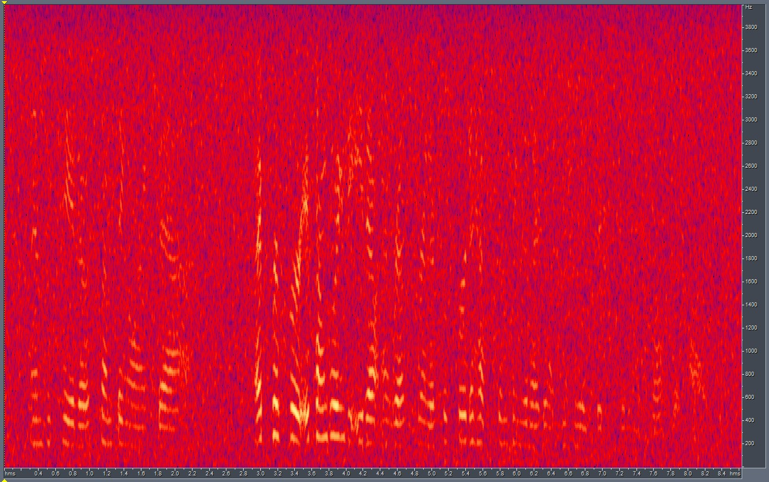
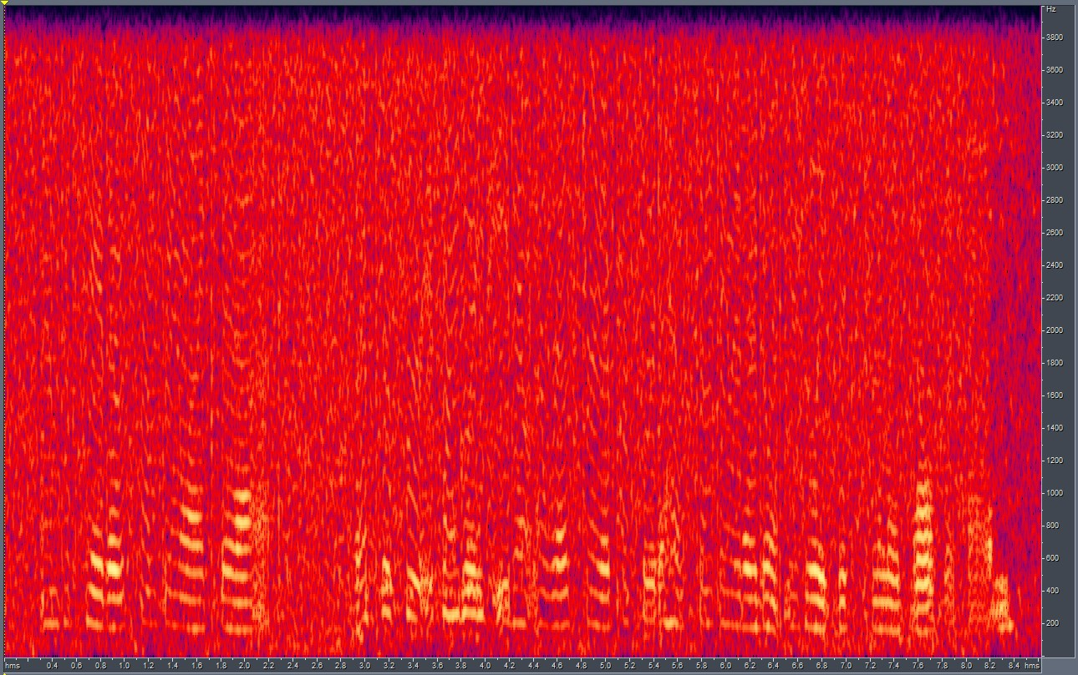

Experiments with CUT: Using Gaussian Noise
Under this, we add Gaussian noise to clean speech files and use them as Domain B; clean speech files remain as Domain A.
We use unpaired samples; 14 audio files (less than 5 minutes combined); about 65 components generated.
Results:
GT
CUT OP
LSD: 8.85

Slide 4
End.

